Slide 1
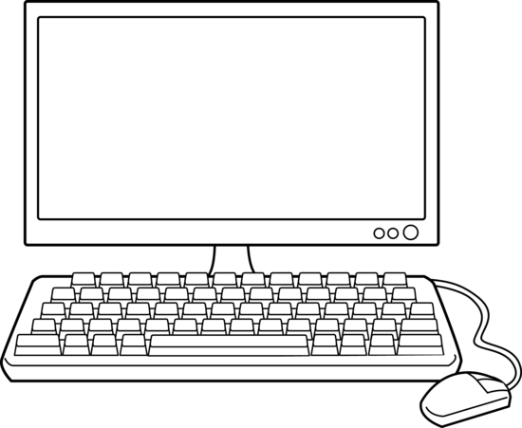
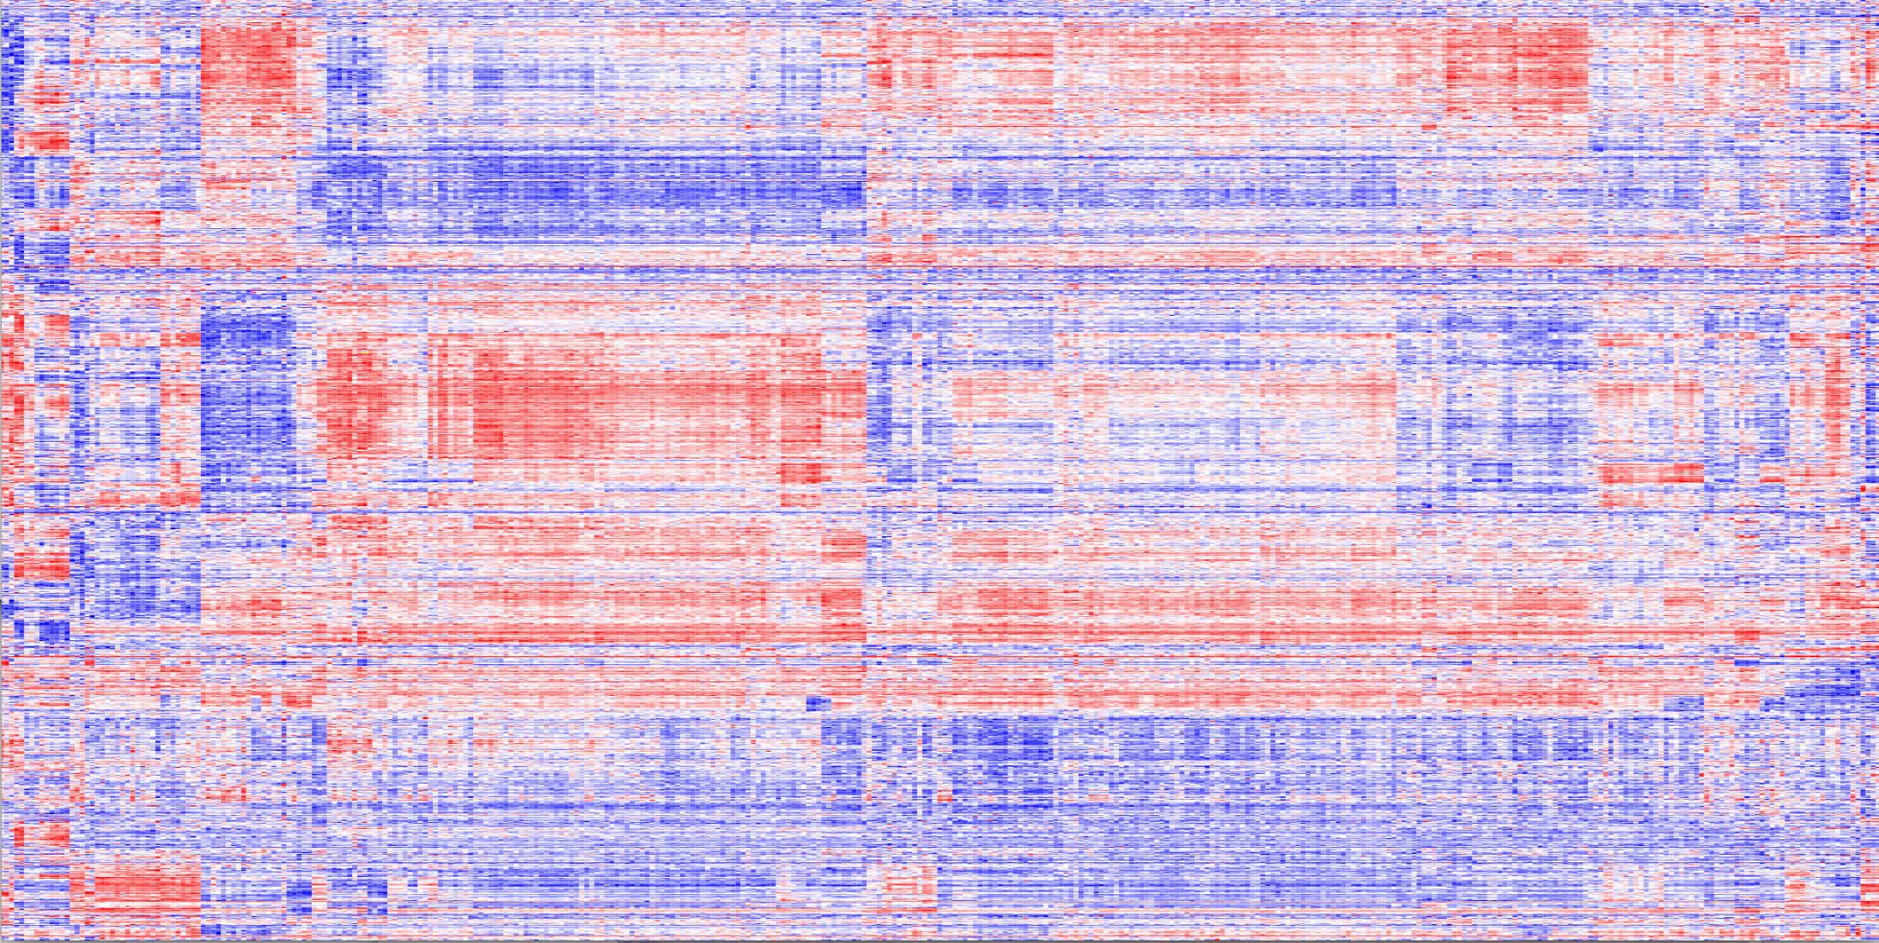
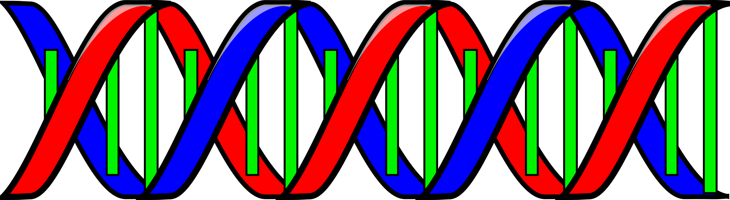

Den nya metoden avslöjar hur små tumörlika 3D-kulturer reagerar på läkemedels-behandling.
Varje 3D-kultur innehåller 50 000 celler och är 0,5 millimeter i diameter. Olika läkemedel
tillsätts i brunnarna.
Varje mikrotiterplatta innehåller
nästan fyrahundra 3D-kulturer,
en i varje brunn.
Genaktiviteten analyseras, viket
ger detaljerad information om hur cancercellerna påverkas av läkemedelsbehandlingen.

Slide 2
The new platform for in-depth analysis of 3D microtumors grown in the lab
A single microtumor contains
around 50,000 cells and has a
size of 0.5 mm. Each is exposed
to a different drug.
Each multi-well cell culture plate contains 384 microtumors, one in each well.
Gene activity for almost 1,000
genes is measured in each micro-tumor, providing detailed drug response information.

Slide 3
The new platform for in-depth analysis of 3D microtumors grown in the lab
A single microtumor contains
around 50,000 cells and has a
size of 0.5 mm. Each is exposed
to a different drug.
Each multi-well cell culture plate contains 384 microtumors, one in each well.
Gene activity for almost 1,000
genes is measured in each micro-tumor, providing detailed drug response information.

