Slide 1

Velkommen!

Slide 2


#mnday
#mynewsdesk

Slide 3

Kort om os
Grundlagt i Sverige i 2004
Kontorer i Danmark, Sverige, Norge, Finland, Storbritannien og Singapore
100+ ansatte
Nyt i Danmark siden sidste Mynewsday
Flere medarbejdere
Flere kunder

Slide 4
Praktisk info
Program (cirkatider)
09:05 Jonathan Bean, Mynewsdesk
09:30 Kirsten Dinesen, Front Page
09:55 Pause
10:10 Kristian Djurhuus, Google
10:35 Jonas Klit Nielsen, Mindjumpers
11:00 Frokost
11:45 Paneldebat
Thomas Heilskov, Danske Bank
Helene Teichert, LEGO
Jakob Holm Kalkar, Carlsberg
Fredrik Erlandsson, Thule Group

Slide 5
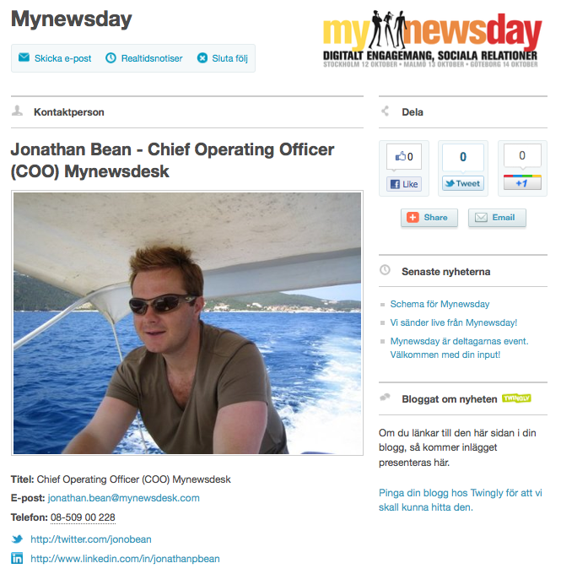

Slide 6
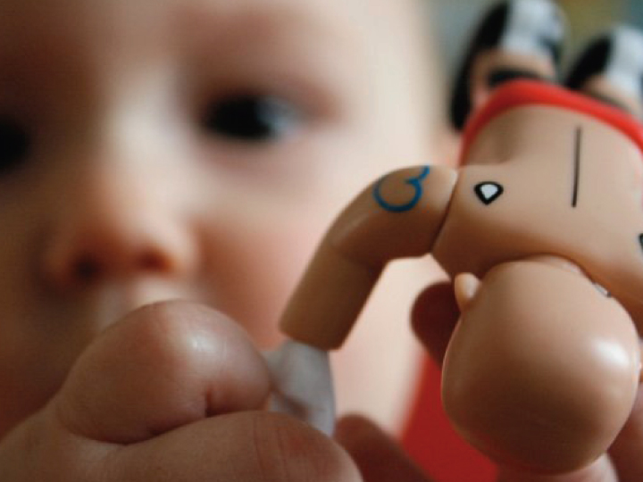
THE FUTURE IS HERE
PR, COMMUNICATION, AND MARKETING TRENDS 2012
Notes:
Thank you – its great to be amongst many of Denmarks leading and most innovative brands and companies in PR and Communication and so nice that so many of you have already started to work with Mynewsdesk.
I don’t know how if you have been ever asked to tell the future? It’s a difficult task
Sometimes I ask myself if experience is an asset or a barrier to innovation in this world we live in now…the people I get inspired from are the ones coming into our business from school all over the world.
Anyway like all of you guys I am just an avid student of PR, communications and marketing and what we have done is collected ideas and thoughts from many of the 25000 companies that work with us and come up with a number of trends that they believe will be important this year

Slide 7
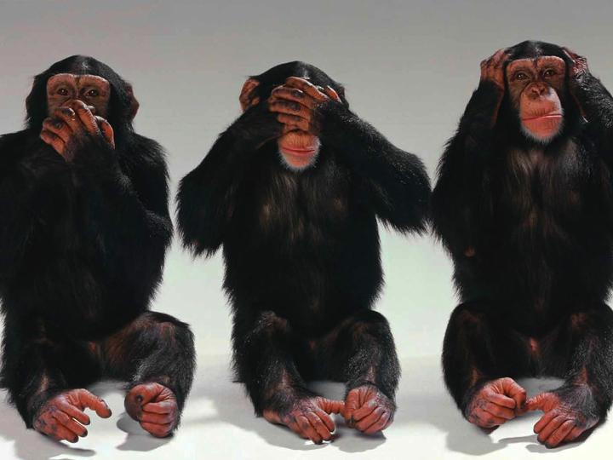
Notes:
Speak no evil, see no evil, hear no evil – could be a social media policy.
This is the picture that best sums up people who give PR & Comms trends presentations
Masterclass – connected lives just making our lifes more stressed
Mother story – Struggle work life / Dad / Exec
Fundemenatal understanding of behaviour is key

Slide 8
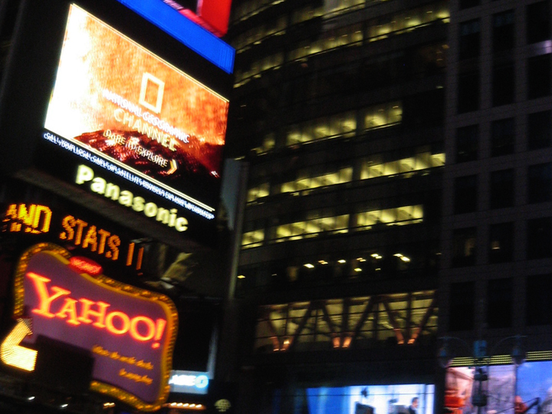
DIGITAL
FIRST
Notes:
Companies and Orgs now consider digital first
Relationships still key but those relationships are moving from analogue to digital
Journalists – Emergence of social journo - Jeff Jarvis – more expansive & less expensive
Media – All media houses adressing structural change of consumption – GUARDIAN leading this in the UK describing itself as a digital organisation even though the majority of revenues come still from Print – Open newsdesk / Norran
Print – a beginning and and end – Online no such thing
PROCTOR AND GAMBLE JOB CUTS – 1,600 – Purchasers of advertsing or agency solutio to content marketers
Search versus Facebook – G still top referer to top 25 news sits globally
Search versus Share – If understanding search most important in last decade, understanding of sharing will be most important this decade
PR&Comms – Need for reverse engineering – Media doing it, take away journalist realtionships , press relases, website – what you got stakeholders – how are you empowering them to tell your story to the world - How to create power users

Slide 9
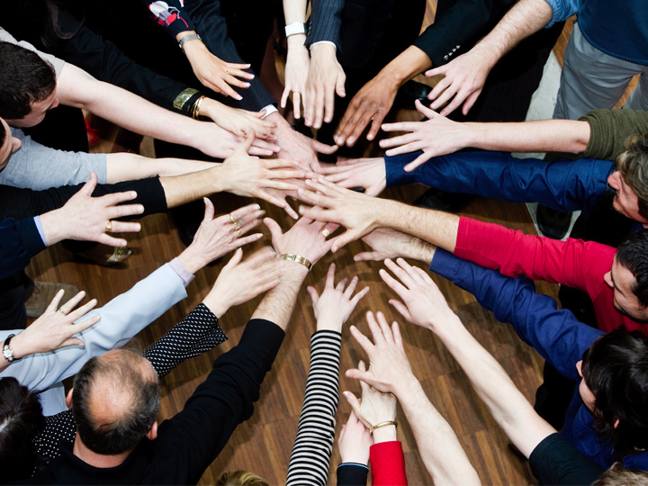
DECENTRALIZE
SOCIAL
MEDIA
Notes:
HOW MANY WOULD SAY SM IS DECENTRALISED IN THE ORG THEY WORK IN HOW MANY WOULD SAY SM IS CONTROLED BY ONE SINGLE DEPARTMENT CURRENTLY
OWNERSHIP– Marketing / PR / Customer Service – None of the above
Started with risk – in 2012 we will start to see the opportunity around socialising the enterprise
Key to success is empowering every employee to be social (Dell, Cisco, Intel)
Its about People NOT logos
Every employee should be a brand ambassador
Control – Acceptance need to loosen, inconsitent message OK Paul Holmes, combo of central support and local outreach
Problem – Trusting non marketers to tell your brand story
Solution – PR/Comms need toenable by communicating cultural and shared values – Not on message employees
Fundemental organisation change needed – If employees not good at social media its not a SM problem…it's a hiring and int. Comms problem

Slide 10
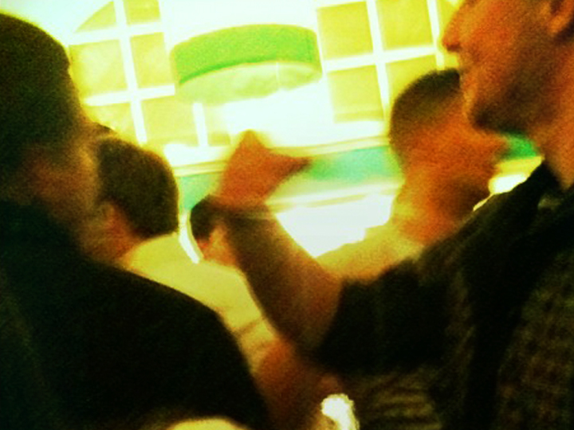
I GET BY WITH
A LITTLE HELP
FROM
MY FRIENDS
Notes:
We’ve all heard about UGC and maybe even tried to get some, but what do we do with this. In 2012 crowd generated digital story telling will be fully embraced.
Firstly – do you know who your friends are (or are they just anonomous contacts on an email list) – refer to KB
Just like real life we will be defined by who surrounds us both online and offline
Start building and interacting with you network, major MND focus
Start with employees, customers and partners (TREAT EMPLOYEES LIKE CUSTOMERS AND CUSTOMERS LIKE EMPLOYEES)
Best and most engaging stories will come from your crowd – Are you really listening (Every Tweet is a story – SouthWest Airlines example)
Facebook Tagging – rewards for brand ambassadors, increased fans base, links to landing pages
Credibility & Brand Authenticity Key
How and should you use UGC that’s the question – Coke a good example LETS TAKE A LOOK AT THESE VIDEOS

Slide 11
Pga. filens størrelse er videoen fjernet fra præsentation. Se YouTube-kanalen her: http://www.youtube.com/user/expedition206
Notes:
Expedition 206 (3 backpackers funded to go to 206 countries)
V
Coke Around the World (Duane Perera, Canadian Dumped 48 cities, 36 countries)
Results
206 (36k channel views, 105k views, 992 subscribers)
Duane (55k channel views, 500k+ views, 3000+ subscribers)
Talks of talks with Coke execs but no comment – missed opportunity

Slide 12
Pga. filens størrelse er videoen fjernet fra præsentationen – se den i stedet her: http://www.youtube.com/watch?v=QRcqrz2LB30.
Notes:
Expedition 206 (3 backpackers funded to go to 206 countries)
V
Coke Around the World (Duane Perera, Canadian Dumped 48 cities, 36 countries)
Results
206 (36k channel views, 105k views, 992 subscribers)
Duane (55k channel views, 500k+ views, 3000+ subscribers)
Talks of talks with Coke execs but no comment – missed opportunity

Slide 13
I GET BY WITH
A LITTLE HELP
FROM
MY FRIENDS
Notes:
Expedition 206 (3 backpackers funded to go to 206 countries)
206 (36k channel views, 105k views, 992 subscribers)
V
Coke Around the World (Duane Perera, Canadian Dumped 48 cities, 36 countries)
Duane (55k channel views, 500k+ views, 3000+ subscribers)
Results
Talks of talks with Coke execs but no comment – missed opportunity

Slide 14
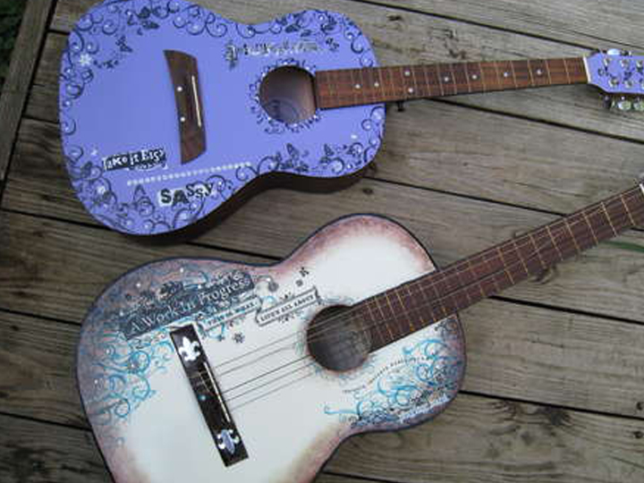
CUSTOMIZE
THIS!
Notes:
News is and will become more personal
You will not go and find news – news will find you
Last year talked about the emergence of Zite, Flipboard, Pulse, Trove etc
People more interested in what their friend say is news worthy NOT a news editor
All these services depend on the network created around people but the more engagement and compartmentalisation of peoples social networks the more important personalised news will become

Slide 15
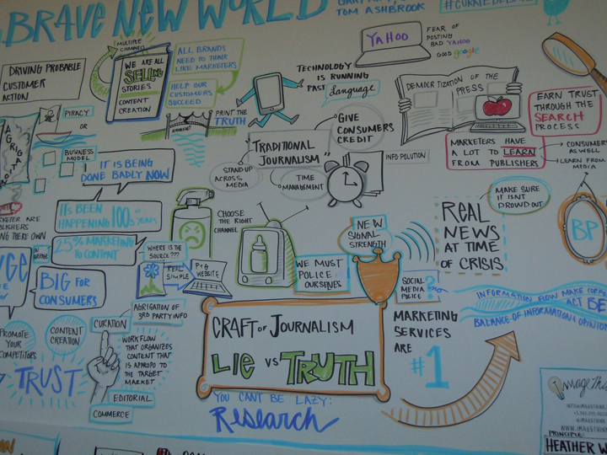
BRAND
NEWS
WORLD
Notes:
MINDSET – Are you there to serve a 3rd part (media)
Can you tell the story yourself
OPPORTUNITY – Over 2 billion internet users
Days of the past – Pitching and Rejection (Hands Up)
No longer but need to realise Info is one of your core Products
STORY TELLERS – Hand up who came over to the dark side from journalism – PR great
INFLUENCERS – All in the search – not easily fooled / Adress Info need – monitor and engage in real time
CREDIBILITY – Either Buy (Plenty of Journos) or Earn – Offer value Thought Leadership
CISCO- The Network
Revamaped Newsroom (Name crowdsourced from FB)
Journos hired –Fortune, WSJ, Forbes, AP – create content on any news site
PURPOSE – Tell stories + share info of interest to us
(CREATE, CURATE,SHARE)
TIPS – Offer value, Push to relevant audiences, Core themes, Don’t always talk about self, Repeat)
NISSAN – created own newsroom operation – hired journos – If we have a good story to tell we will tell it ourselves
Dan Sloan ”Traditional PR is just not that sophisticated, much of it is unwatchable and unreadable” 17 years at Reuters
Existing communications tools / industry
Simon Sproule – Newsroom/MediaCenter is the first lovechild from the coupling of marketing and PR
JYSKE BANK– Created own TV Channel, Journos Leadinf Danish TV anchor

Slide 16
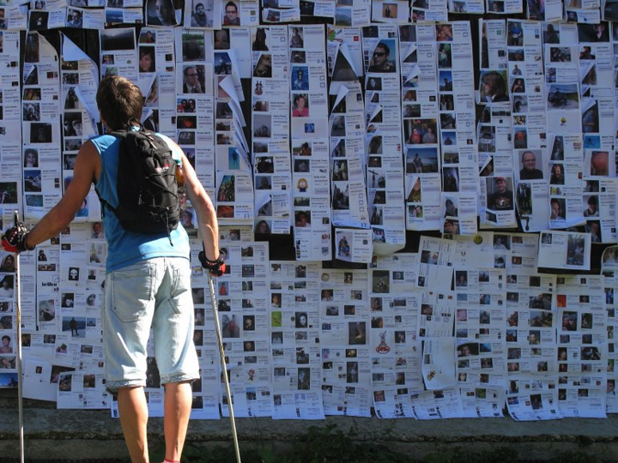
ONLINE GOES
OFFLINE GOES
ONLINE
GOES OFFLINE
GOES ONLINE
GOES
OFFLINE…
Notes:
Our consumption of digital media is now taking place in an offline environment which is why the meger of the two experiences will be key in 2012.
Swiss village Obermutten latest example of Online – Offline – 6,000+ fans in 2 weeks (Print the fans to join the community – comms via YouTube)
INTEGRATED COMMUNICATION – Always talked about integrted campaigns, paid & earned but will become more important – CONNECTING THE DIGITAL WITH THE PHYSICAL WILL BE KEY
Winner of the Cannes Lions Grand Prix for PR a good Eg BBDO Melbourne (SHOW VIDEO)
But you don’t need to have such a huge budget in place
Look at the opportunities offered to you by LBS (Foure Square / Gowalla)
Jimmy Chew Scavenger Hunt

Slide 17
Pga. filens størrelse er den fjernet fra præsentationen – se den i stedet her: http://www.youtube.com/watch?v=BDbvAEcP_2k

Slide 18
ONLINE GOES
OFFLINE GOES
ONLINE
GOES OFFLINE
GOES ONLINE
GOES
OFFLINE…

Slide 19
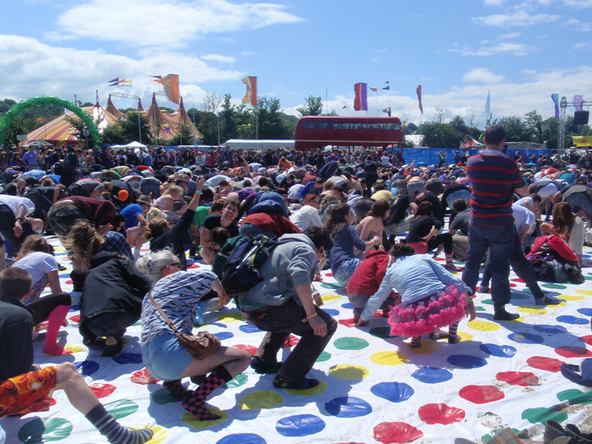
COME OUT AND
PLAY
Notes:
Gamification of all online experiences will start to dominate all online activities in 2012
Personal Experience – Discovering of the fun of 4Square – End result more bus for Wafflan
HOW MANY PEOPLE HERE HAVE PLANS TO GAMMIFY THEIR COMMUNICATIONS IN 2012
Physchology – 2010 HBR – what motivated people at work – sense of progress
Lots of brands doing great work in this eg Nike, Starbucks, BMW a great swedish example

Slide 20
Pga. filens størrelse er den fjernet fra præsentationen. Se den i stedet her http://www.youtube.com/watch?v=WMWu1h_6OfE

Slide 21
COME OUT AND
PLAY
Notes:
Gamification of all online experiences will start to dominate all online activities in 2012
MEDIA – Also looking at this – Appearance - glossy, Depth – news, Experience – gaming)
Improve commenting, More creation and sharing, think different about monetization
PR & Comms even starting to do it –
FLUID PR
Journos must complete quests and missions to get acces to comapny announcements
Media competing for access to exclusive stories
Badges for Most in depth analysis, Most sensational headline
Think PROGRESS, GOAL, MISSION, USER EX, REWARD

Slide 22
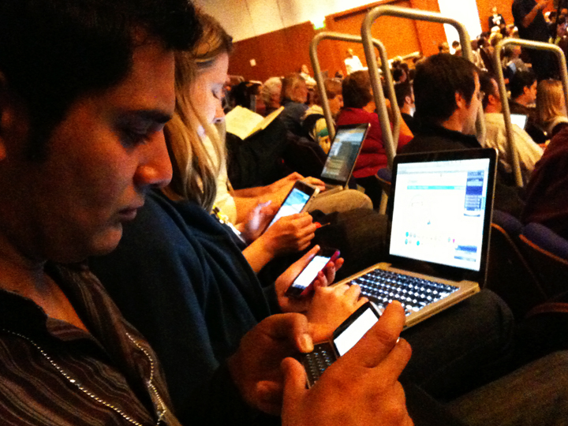
LIFE
ON THE
GO
Notes:
Not going to go into the numbers but we know this trend has and will continue to dominate our lives over the next few years
3 behavioural trend
Not going to go on about the numbers but perhaps we should all remember Steve Jobs.
CONVENIENCE – Less is more Contributes to an easy & effortless way of life
Transform culture and business / get things done faster / Offer tangible value / QR codes to Near field communication
WHO HERE HAS USED QR CODES IN THE LAST 12 MONTHS – again connecting digital with the PHYSICAL
CONTEXT – Relevant information when you need it / connect the digital with the physical / Curate the most relevant local knowledge in realtime
FUN – maybe the best thing about mobile is it ability to make life fun – SHOW MCDONALDS VIDEO

Slide 23
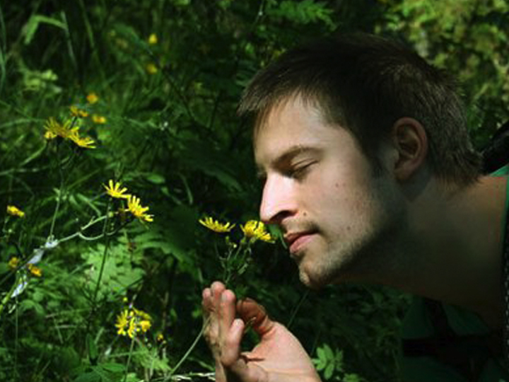
IN THE
EYE
OF THE BEHOLDER
Notes:
Qwiki – Narrated Stories on the Web Information into experience
Augmented Reality – Cinema – again conecting Digital with physical
Was never a fan of Augmented Reality when introduced to it two years ago but can now see the connection of digital to the physical and the introduction of fun and enjoyment in peoples lives may have something here.
Intel’s museum of me

Slide 24
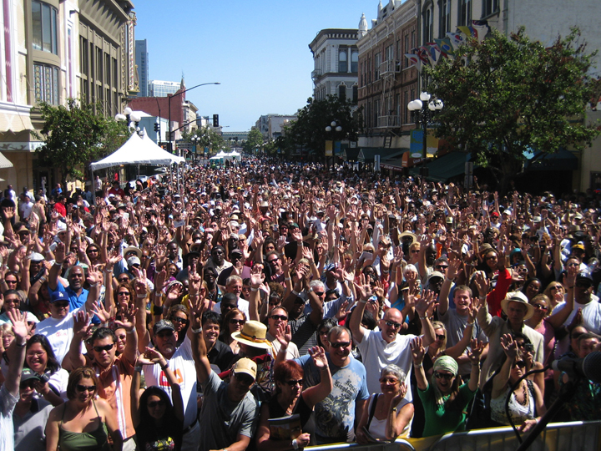
CONTENT IS KING,
BUT IT’S THE
PEOPLE’S
KINGDOM
Notes:
Talked last year about Business to people
Now truly P2P
Brand defined by who surrounds it
Control – NEED TO LET GO OF THE BRAND AS A SELF CENTERED MEDIA OBJECT
EMBRACE THE BRAND AS A DYNAMIC COLLABORATION WITH CUSTOMERS/ COMMUNITY
CUSTOMERS not just buying the products but they are buying the people both online and offline – Emotional Buying
NETWORK IS KEY – Who is surrounding you and your competitors on the web; How are you Engaging with them; What are you doing with what that engagement and innovation
IN an article from think with Google their think Quarterly Publication said INFORMATION IS IN SEPERATBLE FROM THE PEOPLE THAT CREATE IT – I WOULD SAY THAT WE ARE MOVING INTO AN ERA WHERE INFORMATION AND ORGANISATIONS ARE INSEPERABLE FROM THE PEOPLE WHO SURROUND IT
Understand the impact that technology is having on human behavior
Add value and a sense of life improvement through your use of technology in communications and you will be a winning communicator and marketer in 2012

Slide 25
Thank
You

Slide 26

?
?
?? ???? ???? ??????? ??? ??? ????? ???????????????????????? ? ??
?
?
?

Slide 27

Mynewsday The stupid gap
Maj 2012

Slide 28
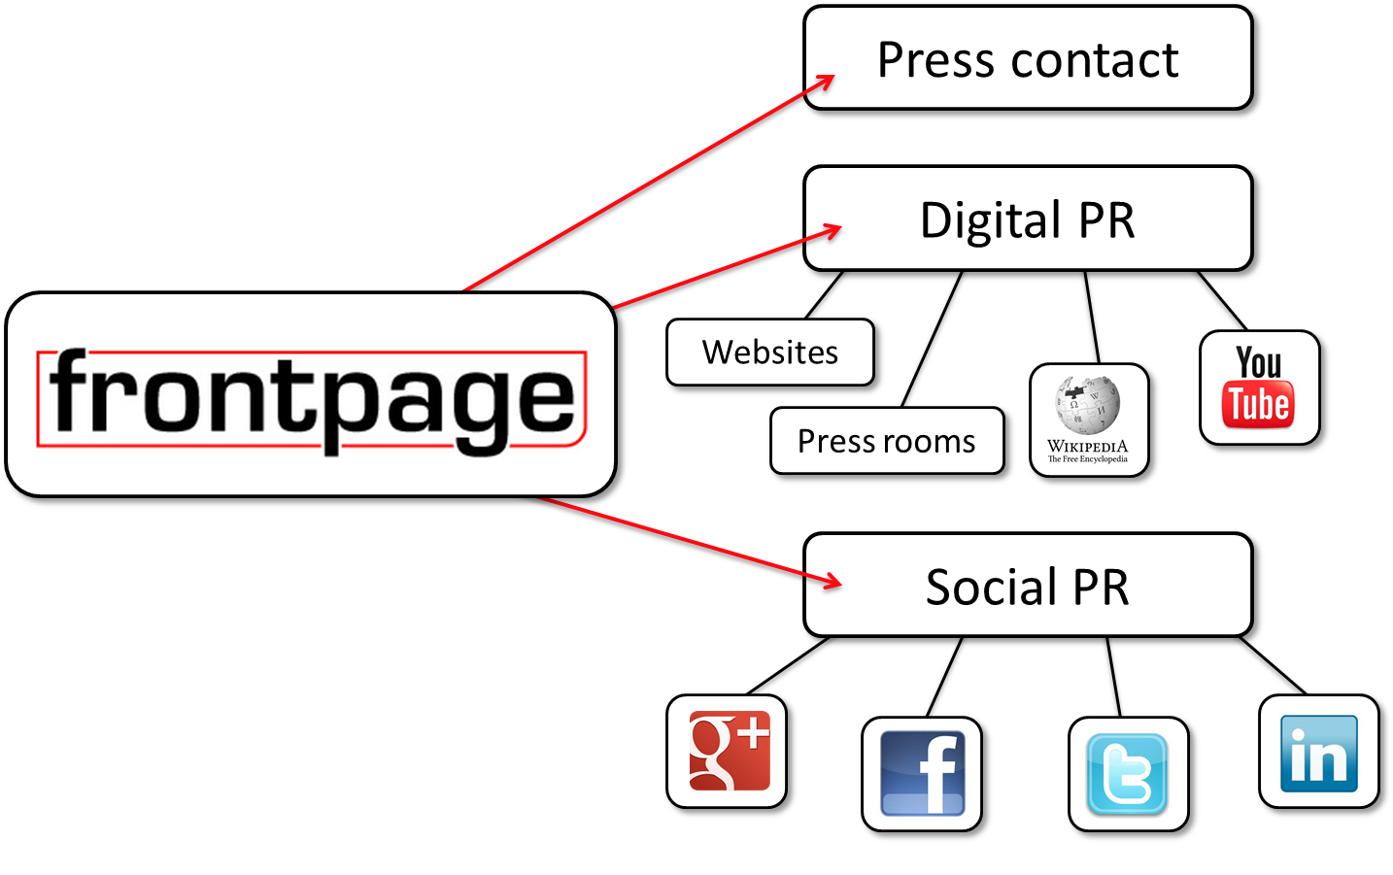
Sådan arbejder vi med digital PR

Slide 29
Agenda
Hvorfor er det så vigtigt at tænke I digital PR
Hvilke udfordringer er der
Hvordan arbejder man med digital PR
Dynamic story Telling
Sådan udvikler man den gode historie

Slide 30
Digital PR
Digital PR =
Den TOTALE mængde informationer der er tilgængelig om virksomheden i medierne
Mål = at informationer er søgbare, tilgængelige og nyttige
Presseomtale er et sekundært mål
At skabe trafik
At være del af et troværdigt miljø
Er spreadabel
Konsekvens
Ny måde at udføre PR på
Ny måde at udvikle virksomhedens PR materialer på

Slide 31
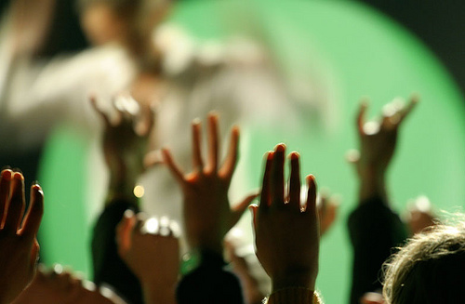

Slide 32
Stupid gap
Antal
Data om spredning af info
Ekko af information
Stupid gap
Original
information
Information

Slide 33

Brand i den digitale tidsalder
Own media
Website
Press releases
Brocure
Magazines
Videos
Websites
Display media
Slideshare
Youtube
LinkedIn
Google+
Kontrollerede
medier
Editorial media
The press
Newspapers
TV & Radio
News on the internet
Blogs
Wikipedia
Earned media
Facebook
Google+
LinkedIn
Youtube
Twitter
Ukontrollable
medier

Slide 34
Hvor leder forbrugerne efter information - Prioriteret
Online
Offline
Søgemaskiner
Online butikker
Forhandler sider
Pris sammenligning
Redigerede sider – special stof
Forbruger anmeldelser
Blogs og forummer
Sociale netværker
Videos
Brochure
Butiks ansatte
Familie medlemmer
Venner og kollegaer
Print aviser
Tv-reklamer
Tv-programmer
Special magasiner
Bøger
Radio
Google Ro-Po studie Maj 2011

Slide 35
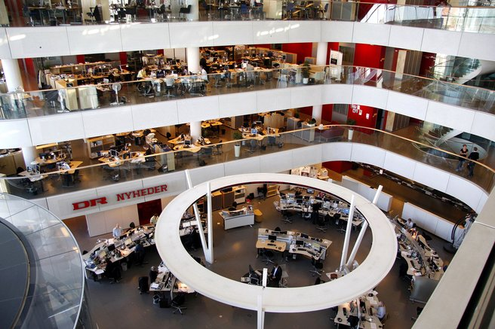
Fremtidens nyhedsrum Bloggere, community & site-managere

Slide 36
Medie økologien
Redigerede massemedier skaber trafik
Masse = stor offentlighed
Dagsorden sættende = debatskabende
Sand interesse skaber ukontrollabel publicity – og søgninger i earned media
Word of mouth
Muliticiplerings effekt

Slide 37
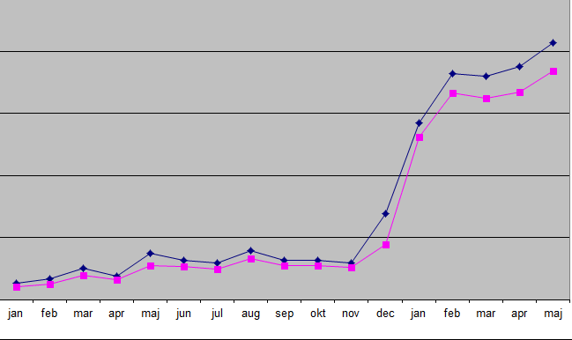
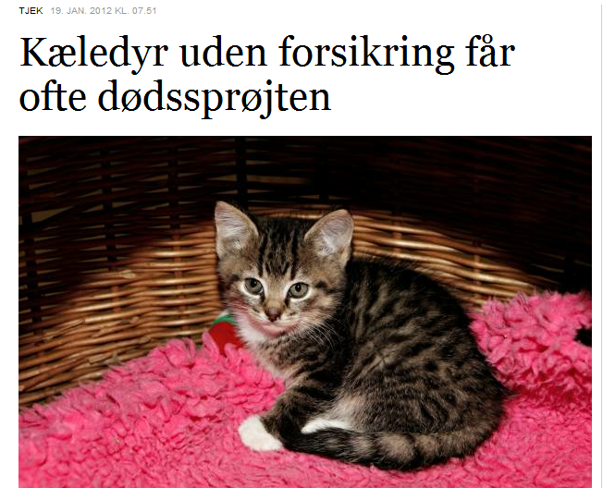

Case: Agris Dyreforsikring
Salget mere end 3 doblet
+ 3000 visninger
på 1 uge

Slide 38
Der er kamp om pladsen i medier Nyhedsdøgnet
TV 18/19
Nyheds bureau
@
@
@
@
@
TV 21/22
Morgen Radio
Dagblade
38

Slide 39
Kamp om pladsen i medierne
Øgning i antallet af nyheder*
1999 32.000 pr uge
2008 75.000 pr uge
Antallet af journalister er uforandret
Redigerende funktioner sparet væk
* Anker Brink Lund, Hvor kommer nyhederne fra?, 2009,
Journalisthøjskolens forlag.

Slide 40
Værdien af presseomtale
Kort sigt
Trafikskaber gennem søge effekt
Langt sigt
Ofte gode søgeplaceringer pga. mediet størrelse
Troværdigt pga. redaktionelt miljø
Spreadabel
Værd at dele og nemt at dele

Slide 41

Dynamikker i digital PR
Own media
Earned media
Own media
PR
Pressemeddelelse
Pressekontakt
”Pressen”
&
Sociale medier
Search
Search relsults
Landing page
Notes:
Presse skaber search = trafik til site
For at komme i pressen = man skal have den gode historie

Slide 42
2 mål med den digitale PR historie
Relevant information
Pris
Åbningstider
Tekniske specifikationer etc.
Høj grad af præcision og informationshygiejne
Search
Interessant information
Perspektivering
Politisk/økonomisk kontekst
Samfundsmæssig relevans, tidens trends
Bruger anmeldelser
Spreadable
Høj grad af troværdighed (baggrunds, eksterne kilder)
Notes:
Search skal opfylde 2 mål:
Relevant information
Pris, åbningstider, tekniske specifikationer etc.
Nødvendigt med Informationshygiejne
Interessant information
Perspektivering, politisk/økonomisk kontekst, samfundsmæssig relevans, tidens trends, bruger anmeldelser, spreadable,
Nødvendigt med den gode ide, baggrundsinformationer, eksterne kilder - troværdighed

Slide 43
Digital PR Eksekvering
Relevant
Del al viden og alle materialer på SEO optimerede platforme
Presse rum
Brug distributions services som er SEO optimeret
Del materialer på on online services
Slideshare
Google+
LinkedIn
Facebook
mv

Slide 44
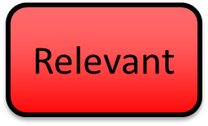
Digital PR Eksekvering
Sørg for at PR materialer er delbare
Brug det enkelte format
Simple tekstfiler uden formatering
JPG fotos med tydelig navne & tags
Undgå
PDFere
Flash animationer

Slide 45
Spread the news
Editorial & earned media
Nå frem til de rigtige journalister
Bring PR materialerne til liv ved at poste det i de sociale medier
Kontakt fremtidens redaktører
Bloggere, community managere, site-managere
Wikipedia
Hvis muligt - brug Wikipedia proaktivt i PR
Brug fotos aktivt
Nye fotos
Husk at tagge fotos og gør dem søgbare

Slide 46
Wikipedia som PR
Relevant
Stærk søge effekt
Næsten altid top resultat
Troværdigt
Journalister, akademikere – og forbrugere bruger informationer fra Wikipedia
Proaktiv og strategisk brug af Wikipedia
Skab egen wiki på site
Post/rewrite artikler på Wikipedia
Brug de samme fraser/kerne ord som i PR
PAS PÅ – vis respekt
Wikipedia sletter reklame snak
Case – Ford Escape
Notes:
Uden apostrof i 2 linje

Slide 47
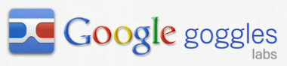
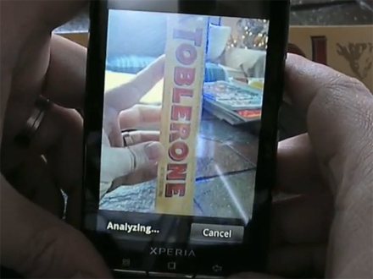
Billeder
Relevant

Slide 48
Definer website som et medie
Interessant
Tænk som et medie – få en redaktør
Konstant udvikling af indhold
Kategorier
Sport – udland – indland – kultur
Salg – eksport – produktionen - CSR
Fakta & Baggrund
Sørg for nyt indhold på site
Planlæg indholdet i en kalender
Lav en strategi for deling af indhold
Hvem skal have hvilke stofområder
Hvordan skal de deles
Direct mails – Nyhedsbreve - Sociale medier
Husk at gøre det

Slide 49
Content Manifesto 2020
Interessant
Story telling – den gode historie
Proces
Fremtid – dynamic story telling
Liquid content
Indhold der har så stærkt indhold at det udvikler sig selv
Definition
Dynamic story telling is the development of incremental elements of a brand idea that gets across multiple channels of conversation for the purpose of creating a unified and coordinated brand experience.
Cocacola Content 2020 Manifesto – Jonathan Mildenhall

Slide 50
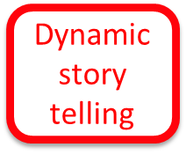
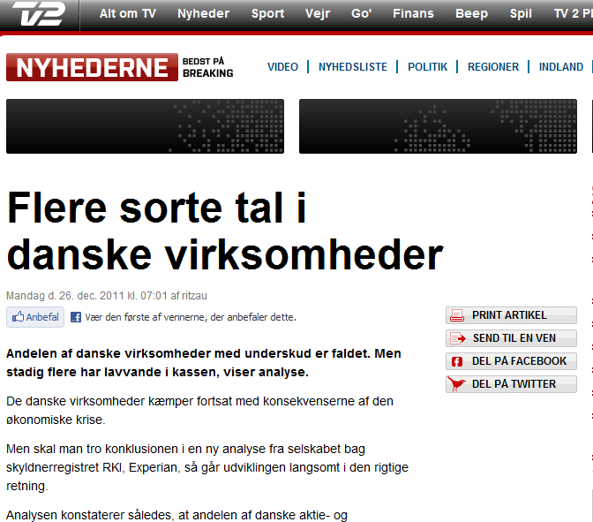
Seriel
Historien har potentiale til at udvikle sig i flere afsnit
Experian
Månedlig konkurs statistik
Etablerings statistik
RKI tal
Strategiske samarbejdspartnere
TV2 Finans
Dansk Erhverv

Slide 51
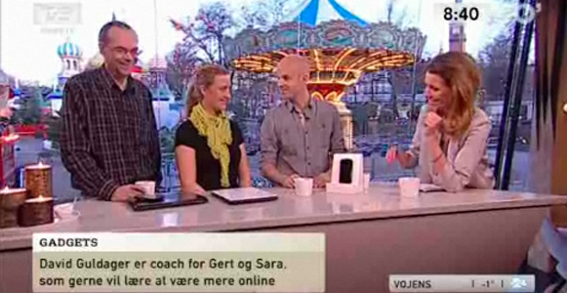
Multifacetteret
Samme historie kan fortælles ud fra mange forskellige vinkler
Google
Altid tæt på missionen
Vi hvad tjenesten kan
Tech make over
TV2 GO Morgen
Notes:
Googles mål er at organisere hele verdens information og gøre den tilgængelig og brugbar for alle

Slide 52
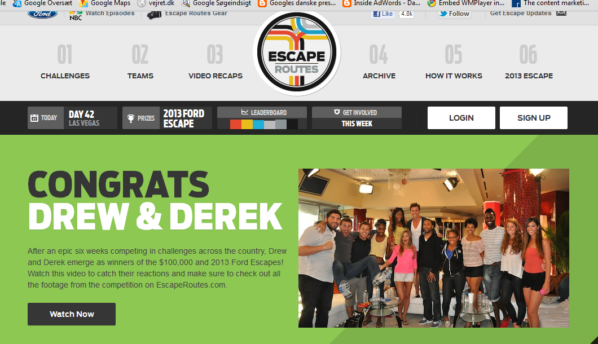


Spreadable
Har potentialet til at blive spredt via earned media
Ford Escape
TV program på NBC
Crowdsourcing via folks egne ruter
Involvering via Google Hangouts på YT
Massiv lokal PR på ruter og vindere
Labels – der deles
Online spil hvor man samler point

Slide 53
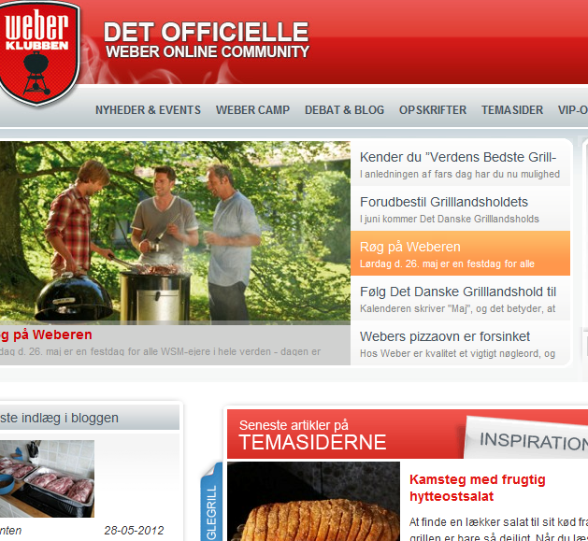
Engagement
Appellerer til at forbrugerne engagerer sig og bidrager
Events driver PR
Opskrifter driver debat
Medlemsskab driver salg

Slide 54
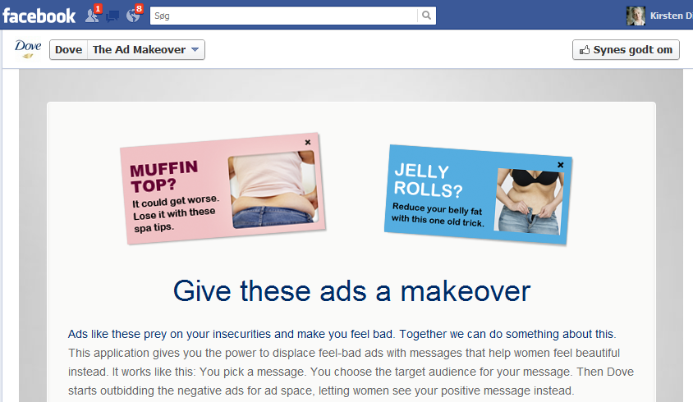
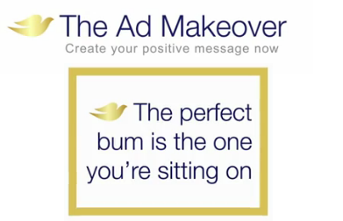
Historien større end den oprindelige ide
Dove - The fight for real beauty
Massiv mængde PR
Debatskabende
Historien kørte af sig selv
Next step
The Ad Makeover

Slide 55
Dynamic story telling i hverdagen 70/20/10 %
Relevant information
70% af indhold
50% af den tid der bruges til at producere indhold
Solidt fornuftigt indhold – der afspejler hvad dine brugere søger efter
OBS – husk søgeords analyser
Search
Interessant information
20% indhold der beskriver produkt i dybden
Baggrund og troværdige informationer
Segment fokus
10% den geniale historie
der måske virker – eller fejler
Måske det nye cornerstone for kommunikation
Notes:
Search skal opfylde 2 mål:
Relevant information
Pris, åbningstider, tekniske specifikationer etc.
Nødvendigt med Informationshygiejne
Interessant information
Perspektivering, politisk/økonomisk kontekst, samfundsmæssig relevans, tidens trends, bruger anmeldelser, spreadable,
Nødvendigt med den gode ide, baggrundsinformationer, eksterne kilder - troværdighed

Slide 56
Sådan bliver historien interessant
Interessant
Se historie et større perspektiv
Historien skal kunne udvikle sig
Lad være med at koncentrere dig om en enkelt nyhed
Undlad at tweake historien så den passer til brandstamp
Husk at der er mange forskellige årsager til at køberne tager en beslutning
Den samlede opfattelse af din virksomhed har betydning

Slide 57




Hvorfor lykkes nogle!
Interessant
Focus på en historie der er større end produktet
Tæt på missionen
Tør have en holdning

Slide 58
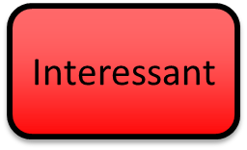
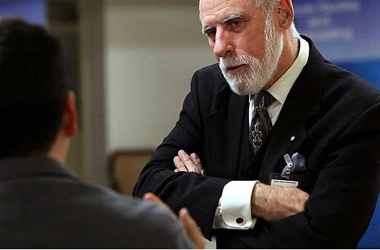
En kultur for åbenhed Vint Cerf & RFCs

Slide 59
Husk 70/20/10
70% - Relevant information
20% - Baggrund og troværdig information
10% - Den geniale ide
Kirsten.dinesen@front-page.dk
+45 22170339

Slide 60
Pause

Slide 61


Mynewsday 2012 Content creation:
The Web is what
You make of it
Kristian Krohn Djurhuus
Industry Manager, Google Denmark
Notes:
Web is what you make of it. Er et populært mantra – tagline I Google her I 2012
Det er sandt for brugerne og det er gælder I høj grad også for annoncørerne som I beskæftiger jer med
Der er nemlig uffatelig mange muligheder for ospå nettet både som brugere og som annoncører – udfordringen består I at følge med og kunne styre sin marketing startaegi I fht denne udvikling
Det har jeg desværre ikke noget entydigt svar på hvordan man gør men jeg synes det kunne være interessant at dele med jer hvlike forbruger trends vi I Google holder nøje øje med for tiden og I den forbindelse give en eksempler på hvilke muligheder det giver os der arbejder med marketing og hvad det har af implikateioner for annoncørerne
Med andreord, hvordan ser vi på udviklingen lige nu og hvad vi selv gør for at følge med
De 3 trends vi skal tale om I dag er:

Slide 62
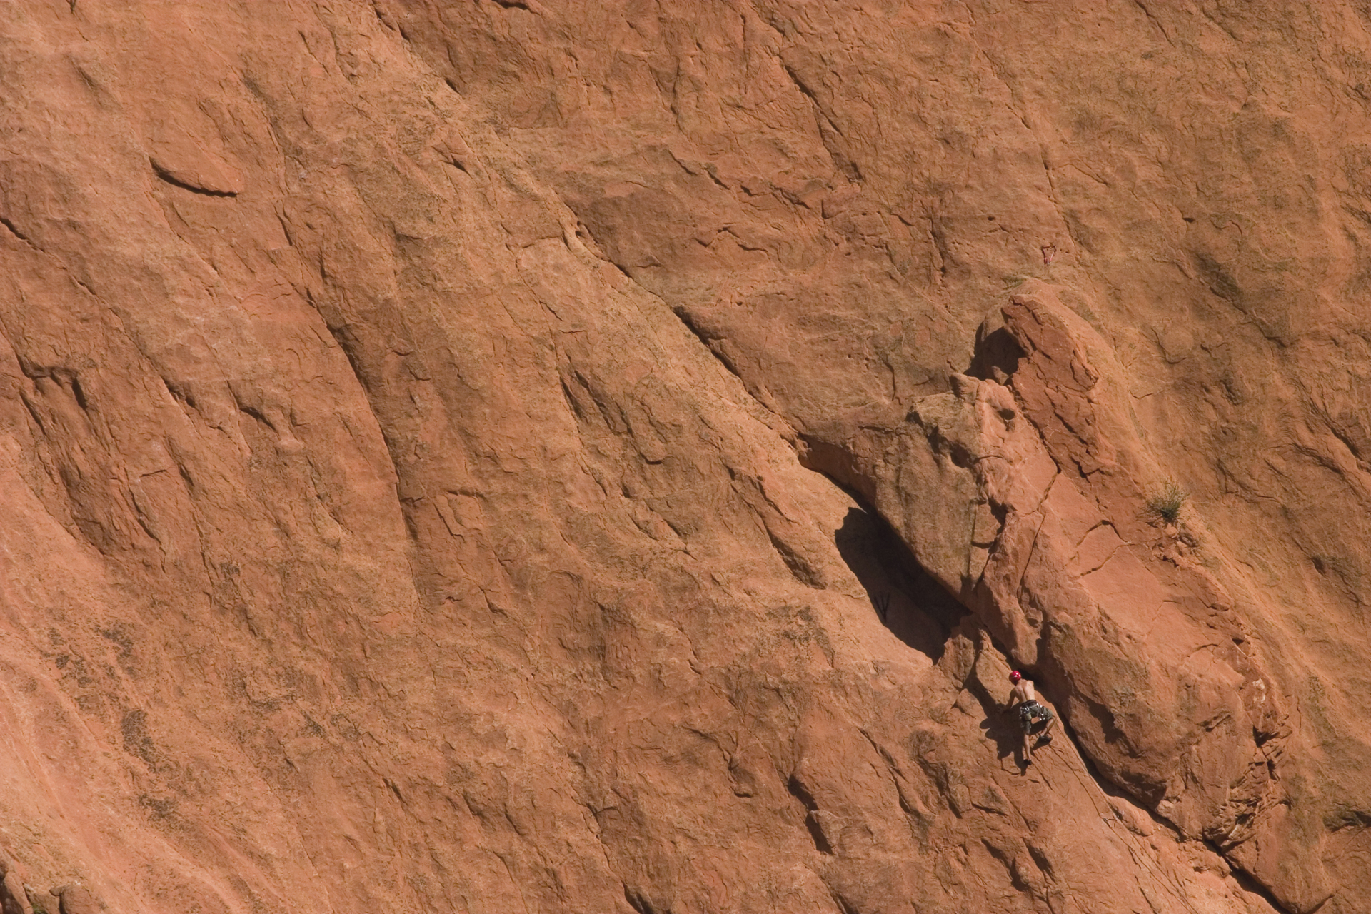
Three Big Opportunities & quiz
1. Discovery – Ads that answer
2. Access – More than one screen
3. Choice – More than one way
4. Optimisation Roulette
Notes:
Opdagelse – der er så meget indhold derude at vi alle er afhængige af kunne søge og opdage nyt indhold
tilgængelighed – der er så mange platforme hvorfra vi tilgå alt dette indhold og vores adfærd bærer præg af det – der giver ikke længere meinig at tale om offline vs. online
Og endelig valgfrihed – med alt dette indhold og alle disse muligheder for interaktion følger også en ny tilgang til mange ting især marketing. Vær klar, fordi konkurrencen vil blive hård!!

Slide 63

2020 VISION
Discovery: Ads that answer
2012
2020
2bn online
5bn mobile
800 exabytes (x10¹⁸)
5bn online
10bn mobile
53 zettabytes (x10²¹)
Notes:
Ok så opdagelse - Lad os lige starte med en øvelse – hvor mange af jer allerede lavet en søgning I dag? Hold hånden oppe hvis mere end 2 etc.etc.
Ok hvor mange af jer har nogensinde søgt efter noget I ikke var intereseret i? –ingen af jer - præcis!
Helt Fundamentalt, så er vores søgeadfærd en præcis og kontinuerlig afspejling af vores adfærd og intereser og hensigter. Bare tænk på hvor meget du selv søger… derhjemme på arbejdet etc. efter en tv reklame…
Idag søger alle - der er mere end 1 mia søg/dag globalt (og ca. 25mio I DK/dag) --- og 16% af disse søgninger er nye!!! Det er 160mio nye søgningerglobalt hver dag!
Og disse søgninger tager folk med overalt på nettet – nettet exploderer I størrelse – 2 nye exabytes af data hver dag. Kortet på slidet er fra det anderkendte design agency – info architects – Det er et af deres icon maps, denne gang tokyo subway. Allerede nu er nettet så kompleks at jeg ikke kan vise det her… og spørgsmålet er om det overhovet vil være muligt om 10 år??
Nettet er vel I virkeligheden uendeligt fordi det afspejler menneskets nysgerrighed som også er uendeligt
Resultatet af denne udvikling er den nye forrbuger adfærd det har skabt – vi tager beslutninger og køber ind og vælger brands på helt nye måder
Og det betyder også at reklamer ikke længere behøber at være noget forstyrrende som vi er tvunget til at se, de kan være et relevante svar på spørgsmål vi selv stiller. Det kræver blotat de besvarer ens spørgsmål på den rette måde – og det er ikke nødvendigvis genenm text annoncer
Ex hvis jeg er ude efter at købe en ferie så bliver jeg jo mere berørt af smukke billeder – ellers hvis jeg skal købe nyt tøj eller booke et hotel I en ny by så vil jeg jo også være langt mere influeret af at kunne se anbefalinger fra mine venner…
Og det bla ud fra disse præmisser at vi I Google fortsætter med at udvikle på vores search ads – og der heldigvis allerede sket meget siden de 95 karater på 3 linier
- lad os se på et par de seneste tiltag på search

Slide 64
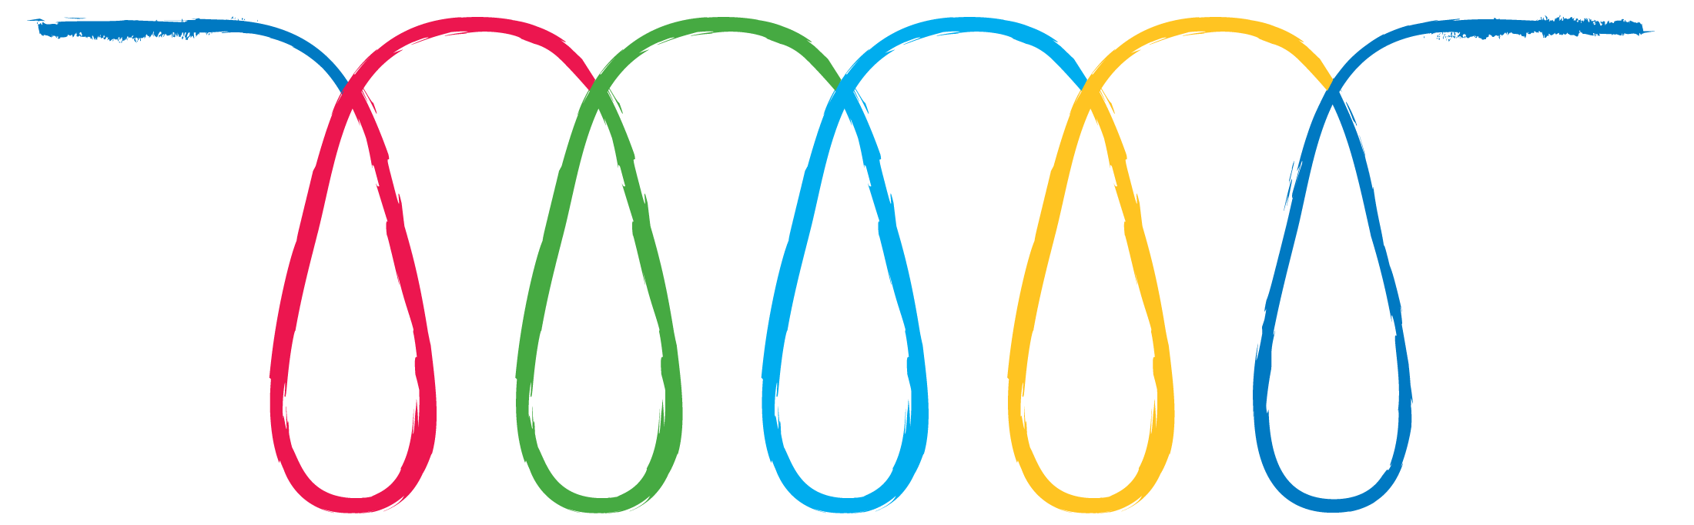
The New Path to Purchase
See a TV ad
Get friend advise
Look at in store
Look for promotion
Need/Want
Purchase
Research
Notes:
Idag er den info som forbrugeren opsøger og finder online I stigende grad den vigtigste I fht deres endelige købsbeslutning
4 ud af 5 forbrugere (78% af alle us brugere) går online for at researche inden et evt køb – og de gør det grundigt! – selv på low involvment produkter som personlig pleje – her er det I gns. 7.0 online research punkter.
Andre ex: biler 18.2 rejser 10.2

Slide 65

The Zero Moment of Truth
Stimulus
First Moment of Truth
Second Moment of Truth
Which becomes the next person’s ZMOT
Notes:
I I Google, kalder vi om denne nye adfærd/process for ZMOT
Nogen af jer har måske hørt om FMOT før – det var P&G som I sin tid navngav interaktionen mellem forbrugeren og varen på hylden FMOT. De mente at forbrugeren besluttede sig I de første sekunder efter at være blevet præsenteret for produktet.
(The “second moment of truth” is when the consumer experiences the product at home, and hopefully with a high quality product, you’ve acquired a customer for life.)
Og selvom FMOT stadig er relevant og vigtigt så må vi erkende at intenettet og søgemskiner især nu er med til at skabe mange brand interaktioner mellem forbruger og brand før de overhovedet står med produktet I hånden – dette er ZMOT
så ligesom I gamle dage er klassik stimulus (tv disply etc.) med til at øge vores behov for mere info om en vare – og I dag bruger vi altsåprimært nettet til denne “opdagelsesrejse” - Og det betyder selvfølgelig også at FMOT nu er MEGET afhængig af hvordan ens tidlstedeværelse er I ZMOT. Den påvirker I høj grad både FMOT!
Med andre ord en robust, målrettet og engagerende online tilstedeværelse er helt essential for jer som annoncører

Slide 66
Superliga Searches: 2006-2012
Steady growth
Source: Google Internal Data 2012

Slide 67
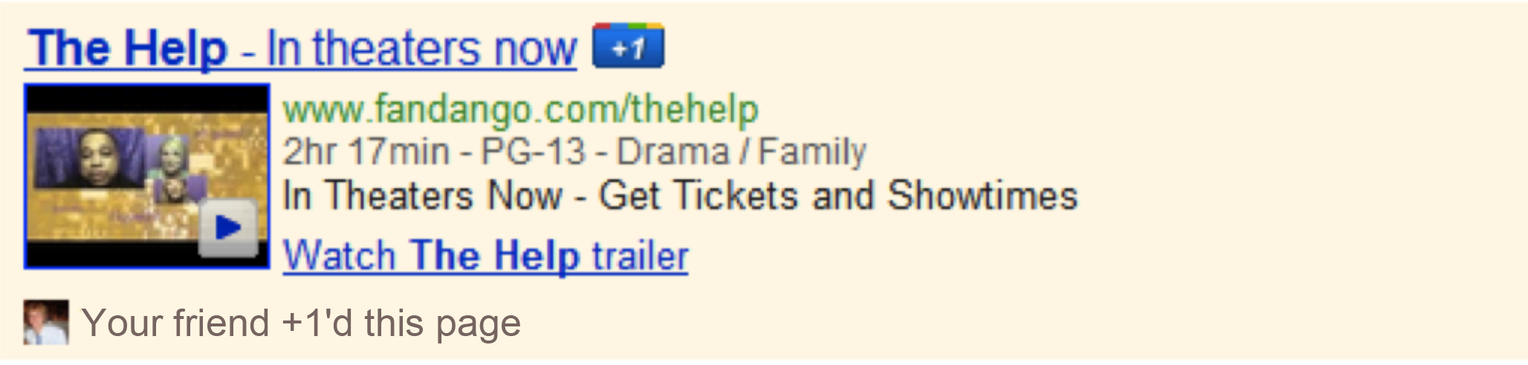

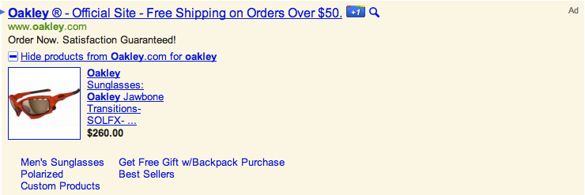
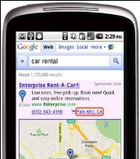
Search Ads are Evolving
Media Ads
Hyperlocal
Mobile Ads
Product Extensions
Seller Rating
67
Notes:
I takt med at folk søger efter mere og mere variendende information så har vi også været nødt til at eksperiemntere og videreudvikle på vores reklamer
Reklamerne skal I højere grad kunne give relevante svar og gerne på en mere rig og interesant måde. Det endelige mål er jo at kunne et svar ALThvad forbrugeren leder efter:
om det så er den nærmeste resturant med en reklame med maps
Hvis de vil sammenligne priser på dig kameraer – at de så kan få en reklame med både billeder, pris info og anmeldelser
Hvis de leder efter en film at de akn se traileren og og spiletider
Hvis de gerne selv vil bestemme hvor de hvor de vil hen på sitet – via sitelinks
Her er et udsnit af de vigstigste udviklinger på search reklamerne I 2011 – forklar
Lad mig vise jer media ads
Hvor mange af jer sørger altid for at komme tidligt nok til at se traileren med når I bio? – de er supergode ik? Vi tænker faktisk ikke på dem som reklame, men I virkeligheden så de er måske de allermest populære reklamer der findes. Ikke nok med vi ikke springer dem over, vi opsøger ligefrem efter dem (2009-10 steg søgninger på trailers på google med 51%)
Så derfor vi udviklede media ads – den ekspanderer og viser alt det relevante info –lad mig vise jer et dk eskempel
Gå til live demo I browser
Spørgsmålet er så om det er en video ad en display ad search ad?? Det er all of the above – og I virkeligheden er det jo ligegyldigt hvad vi definerer det som, det vigtige er at den engagerer brugen på relevant vis

Slide 68

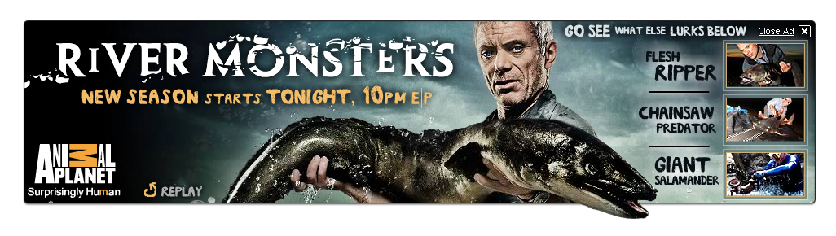
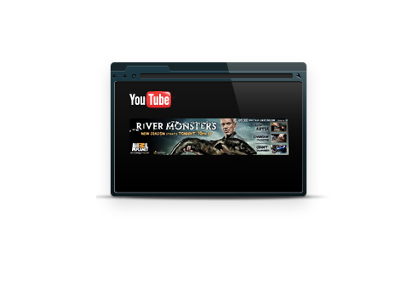
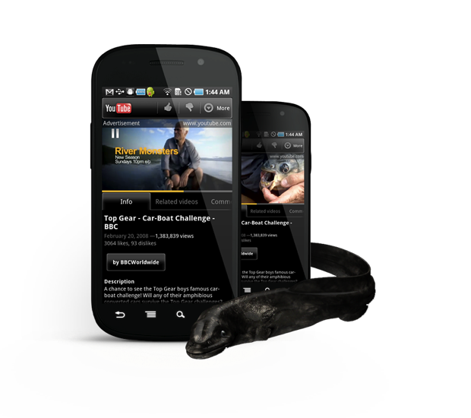
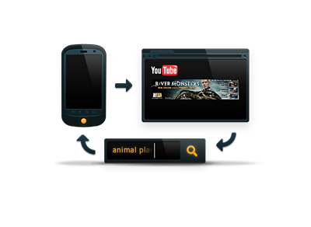
Google Confidential and Proprietary
10
Notes:
Kender nogen af jer programmet river monsters på Animal Planet?
Ok- de har netop lanceret 3 sæson af programmet og da de skulle lancere ville de gerne finde en ny måde at engagere folk på udover deres sædvanlige TV promos
Så de teamede op med vores folk I US og fik skabt en integreret digital kampagne til at støtte op om deres TV – og jeg vil lige vise jer en af de elementer som vi hjalp dem med at lave
Vis film med en “out of frame” video på YT

Slide 69
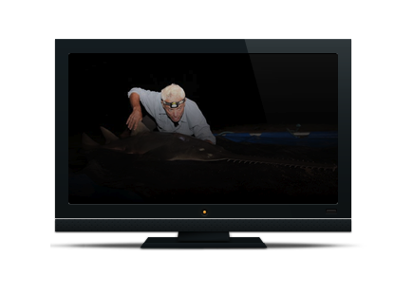
110 million impressions
1.6 million P2+ viewers
Google Confidential and Proprietary
12
Notes:
Cool ik ☺
Resultaterne var også ekstremt gode for AP – premieren havde lige omkring 1.6mio seere som var mere end det gennemsnitlige seertal for både sæson 1 og 2!!!
Hvilket gjorde det til kanalens bedst performende program I stationens historie – et show om grimme fisk vel og mærket - godt gået ik ☺ (David Zaslav, the CEO of Discovery Communications said “This sets a whole new level for digital marketing here at Discovery.”)
SKIFT: Et andet og meget centralt element I hele opdagelsesfasen er den sociale dimension… det er fundamental menneskelig adfærd at ville dele ting med andre

Slide 70
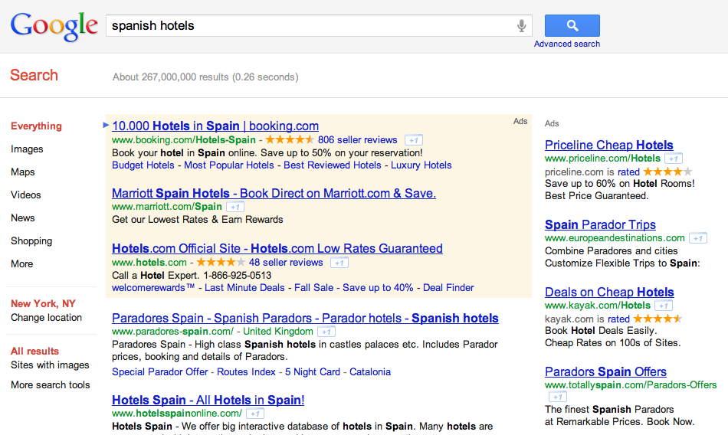
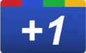
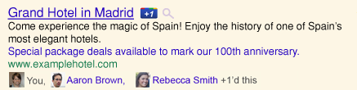
Enabling Relevant Connections
Notes:
Og som de fleste af jer sikkert ved så har vi lanceret Google+ i år
hvor mange har en profil, company page etc.??
Google+ er stadig svær for mig at definere fordi det er en platform I rivende udvikling – jeg ser den som et super vigtigt skridt I retning af at lade mange af vores produkter og platforme smelte sammen via den sociale dimension… eks mail calendaer yt søgning etc.
Ifht til søgeadfærd så spiller den jo også en enormt vigtig rolle – eks hotel søgning her på siden – det bærdene punkt er jo at man som virksomhed er tisltede på det helt rigtige tidspunkt I research fasen og med anbefalingen gøres resultatet så meget mere vigtig
Og det er er altså vigtigt!!! 71% af os er influeret af vores venners/familieI fht købsbeslutninger
Det andet store fokusområde på google+ er naturligvis busienss pages hvor virksomheder/brands har mulighed for at oprette en kommerciel +side og interagerer med dets forbrugere bygge relationer dele indhold og arbejde med publikumssegmentering – og ikke midnst deltage I rigtige samtaler med sine kunder
Et ar de vigtigste elementer I I google+ er circles – muligheden for at opdele dine kunder I forskellige grupper – så du kan sende det helt rigtige bidskab til den rigtige person!
Et andet centralt element I google+ er video delen – muligheden for at mødes med dine kunder face2face via det vi kalder et hangout

Slide 71
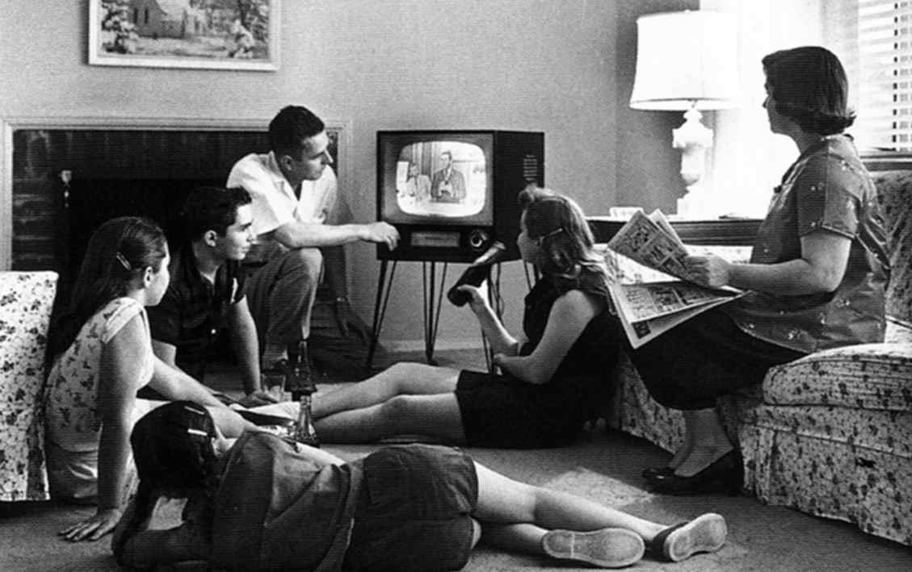
Access: More than one screen
Google Confidential and Proprietary
14
Notes:
Den andet forbruger trend vi beskæfter os med er tilgængelighed (online og offline er no more – nu hedder det non-line)
Tænk bare tilbage på de goe gamle dage som på billedet her – det var altså en nemmere verden!
This was the living room in 1950 [image]. Everyone gathered around the TV. Good wholesome family values. All was good.

Slide 72
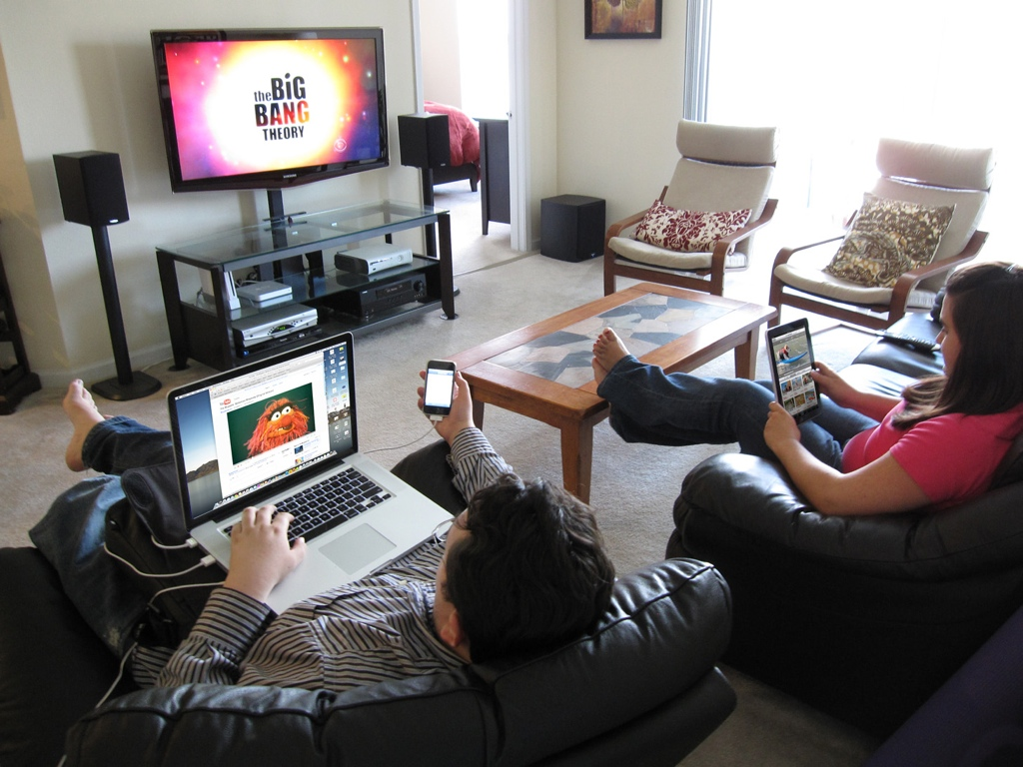
Google Confidential and Proprietary
14
Notes:
Sådan ser det fleste af vores hjem ud I dag – bortset fra de grimme møbler måske ☺
Men ikke langt fra sandheden – vores indtag af underholdning er blevet mget fragmenteret og selvom TV altid har været en vigtigt element og vil fortsætte med at være det så må vi indse TV seening udvikler sig lynhurtigt I øjeblikket og at multitasking er et fænomen vi som markedsføringsprofessionelle er nødt til at forholde sig til
Lad os se hvordan det ser ud I fht vores tidsforbrug - skift

Slide 73
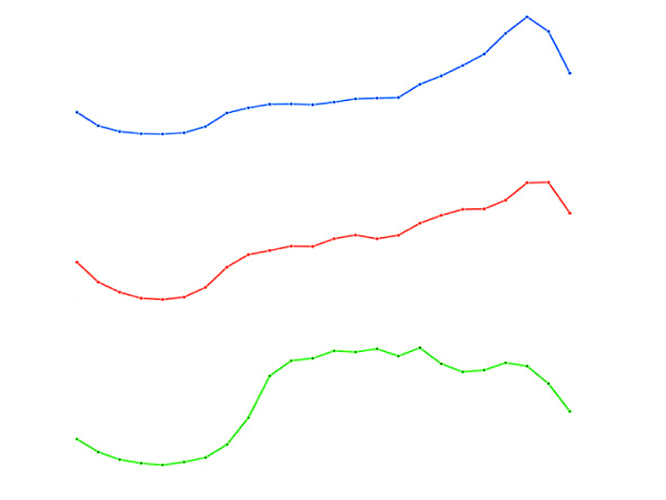
Heavy Search by Pads, Mobile In TV Prime
54%
of danish smartphone users use their smartphones while watching TV
TABLETS Prime Time Peak
MOBILE Prime Time Peak
DESKTOPS Work Day
OVERNIGHT
MORNING
AFTERNOON
PRIME
Source: Google from Ad Age
Google Confidential and Proprietary
15
Notes:
En del af af jer har sikkert set denne fordeling før - Hvad fortæller det osså?
Bla. at folk surfer og søger mens de ser tv, men også at man I stigende grad holder sin laptop lukket om aftenen når man er kommet hjem og har tænt for TV’et. Dette er ekstra tydeligt ved ex store sportsbegivenhder etc. Under reklmaerne søger folk også efter de budskaber de lige er blevet vist – 1 ud af 5 faktisk
Hvad betder dette: jamen det betyder jo bla. At det ikke er nok at køre sine budskaber påTV skærmen man er nødt til at stræbe efter at være på alle skærmene på det rigtige tidspunkt – og endda begynde at overveje om ens search strategi på desktoppen nu også er tilstrækkelig tilhvis vi kan se at forugeren I stigende grad bruger tiden på tablet og mobil om aftenen
TOBY added COMMENT: How many of you use your smartphone or tablet while watching tv? 54%, more than half, of all danish smartphone users use their phone while watching TV. Amplyfy your campaigns with mobile visibility
Så at sprede sine budskaber på tværs af platforme og skærme er simeplthen den eneste frnuftige måde at tackle denne ny forbruger adfærd på og så giver det jo også mening fordi diversifikationen er med med til at booste den investering man allerede har lavet på eksempelvis tv – boost din share of voice!
Og lad os bare kigge hurtigt på den nye forbruger research proces – for meget har jo ændret sig I takt med at forbrugerens patch to purchase er blevet digitliseret

Slide 74
Online Video Is Now Primetime
Notes:
TOBY: ALSO, MULTISCREENS PROVIDES ACCESS TO CONTENT TRADITIONALLY VIEWED ON ONE SCREEN – MOST NOTICABLE MOVING IMAGES – MOVIES, TV AND VIDEO.
OUR FRIENDS AT YAHOO DID SOME INTERESTING RESEARCH:
JUST DURING THE PAST 2 YEARS ONLINE VIDEO CONSUMTION BEHAVIOUR HAVE SHIFTED FROM OPT OUT TO OPT IN DURING PRIME TIME. JUST 2 YEARS AGO CONUMER SHUT DOWN THEIR COMPUTERS AND WATCHED TV ON THEIR TELEVISION SET DURING PRIME TIME. NOW, THE CONSUMERS LOG ON ON THEIR COMPUTERS, PHONES, TABLET TO WATCH ONLINE VIDEO DURING PRIMETIME. (details about study below).
SO, NOW IT´S NOT ENOUGH TO ADVERTISE ON TV DURING PRIMETIME, ADVERTISERS ALSO HAVE TO INCLUDE ONLINE VIDEO IN THEIR BUDGETS.
-------------
En studie från Yahoo visar intressant trend I hur vårt beteende hur vi konsumerar online video har ändrats.
Vi tittar på längre klipp
Vi tittar på onine video klipp på kvällen under prime time - då vi bara för två år sedan I mycket större utsträcking stängde av datorn och på TVn.. Så streamar vi nu längre material – shower filmer på kvällen –
A new study by Yahoo (embedded below) shows that online video watching habits are shifting. People are watching longer videos and watching more at night during primetime. The chart above shows when people watch videos online. The blue line is today (2011) and the dotted line is two years ago (2009). The two lines show more than a 30 percent divergence during primetime.
So what changed? Peak online video viewing today is during prime time, between 6 PM and 9 PM. Only two years ago, prime time showed the biggest dip in online video viewing as people turned off their computers and turned on their TVs. But now, more people are streaming TV shows and movies from services like Netflix and Hulu, and they tend to watch those videos during the same time period they previously watched regular TV. While people may not yet be cord cutting, this data suggests that online watching does encroach upon regular cable and satellite TV watching.

Slide 75
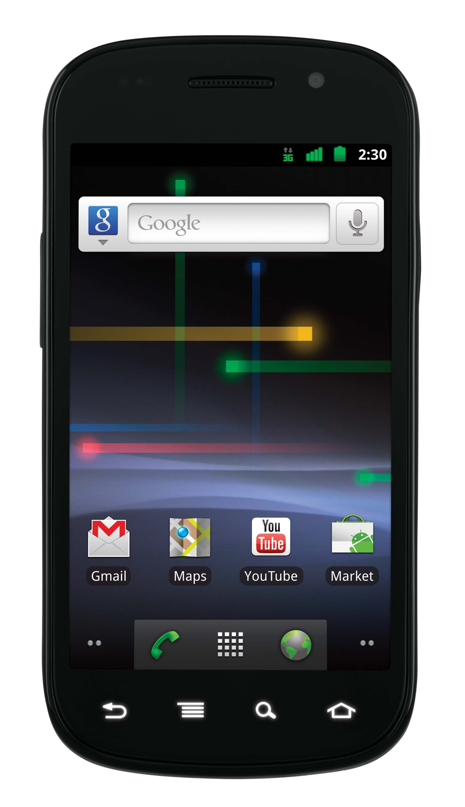
Google Confidential and Proprietary
Notes:
Eksplosinen I væksten af mobil på både antal håndset, ydeevne og mobile trafik er enestående!
Search på mobilen er 5 doblet på 2 år
50% af al trafik på maps kommer fra mobiler
Over 400m yt clips afspillet på mobilerne hverdag
TOBY: WHAT ABOUT SOMETHING SOME OF YOU MIGHT CARE MORE ABOUT THAN WHAT CONSUMERS ARE USING THEIR PHONES FOR: MONEY, SALES, COMMERCE. IN DENMARK mCOMMERCE SALES GREW WITH 380% YoY 2011-2010. mCOMMERCE IS EXCPECTED TO COUNT FOR 5% OF TOTAL ONLINE SALES IN DK IN 2012. BUT WITH A SMARTPHONE OR A TABLET IN ALMOST EVERYONES HANDS THESE DAYS WHY WOULDN´T mCOMMERCE MAKE UP MORE THAN 5% OF TOTAL ONLINE SALES?
transition to next slide: because…
Osv osv osv
Og Mobilen er jo en drøm opfyldelse for enhver I marketing – fordi den byde rpå så mange spændende mulighder for at gøre ting der bare ikke var muige for få år siden

Slide 76
Champions League Finale - May 19th, 2012
Just before the game starts more clicks are generated on mobile devices than on desktops.
More clicks generated on mobile devices than on desktops
Google Internal Data 2012: Analysis based on a set of keywords - A full picture cannot be guaranteed.

Slide 77

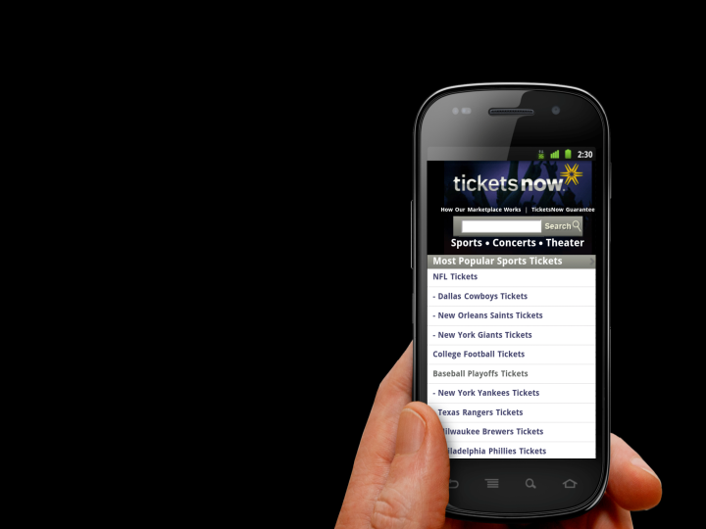
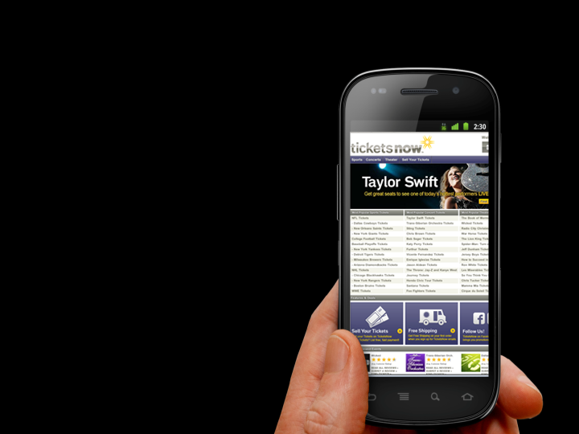
79%
of large online advertisers do not have a mobile optimized landing page
Google Confidential and Proprietary
77
Google confidential
Notes:
….. a majority of online advertisers haven´t bothered to create mobile optimized landing pages.
Til trods for alt udviklingen på mobil så er det også uforståeligt for os at 79% af alle Googles største kunder/annoncører ikke har en side er optimeret mod mobilen…???
TOBY: HOW MANY OF YOU HAVE A MOBILE OPTIMIZED LANDING PAGE? HAND UP FOR YES, HAND UP FOR NO, HAND OF FOR I DON’T KNOW. OK.. THANK YOU. WE HAD A LOOK AND IT SEEM LIKE ONLY 2 OF YOU IN THIS ROOM ACTUALLY HAVE A MOBILE OPTIMIZED CUSTOMER EXPERIENCE
Utroligt synes jeg faktisk – især når man kender konskvenserne – I kender det slev når desperat har brug for noget på et site der bar eikke virker på mobilen – man bliver sindssyg!
Faktisk 11% råber decideret af deres mobil – og 40% vælger at gå til en konkurrent side for at prøve lykken – Seblot de seneste resultater…. skift

Slide 78
Watch out! Mobile users hold grudges…
61%
are unlikely to return if they had trouble
said they’d visit a competitor site instead
would have a negative overall perception
40%
19%
source: compuware, “why the mobile web is disappointing end-users.” march 2011
Notes:
AS YOU CAN SEE, MOBILE USERS HOLD A GRUDGE…
… SO, WE KNOW THAT USERS LOVE MOBILE OPTIMIZED EXPERIENCES AND WE ALSO KNOW THAT COMPANIES DON’T PROVIDE THEM. SO WE TOOK ACTION AND CREATED A SOLUTION TO HELP COMPANIES SELL MORE AND MAKE THEIR CUSTOMERS HAPPY….
NEXT SLIDE

Slide 79
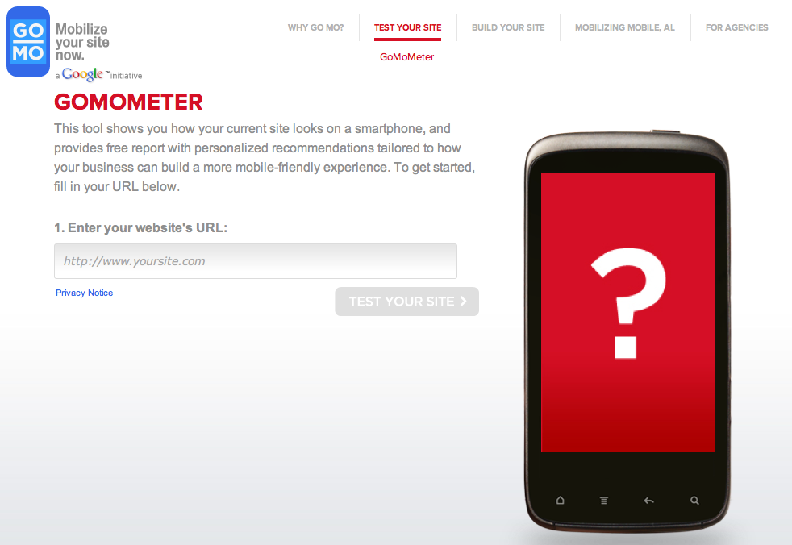
www.howtogomo.com
Google Confidential and Proprietary
18
Notes:
En af de nyeste tools vi har lanceret er howtogomobile
Super nemt og jeg vil anbefale jer alle at teste det og tage en snak med jeres bureau om hvad I kan gøre for at komme ud på mobilen!

Slide 80
50%
Notes:
vores bud er at 50% af alt reklame vil være opt in inden for en kort årrække
Skræmmende? Ja også for os… men tænk over det, det er jo den retning som teknologien udvikler sig… uendelig valgmulighder for forbrugeren… det kommer til at stille store krav til både kreativtitet og eksekvering
En af de formater som allerede bygger på dette præmis er på YT hvor vi for ca. 1 år siden lancerede TruView… det er en pre roll med mulighed for at skippe annoncen.. Vi ville se hvad der ville ske…
Og lad os bar elige lave en hurtig og meget uvidenskabelig test her: - viser jeg en reklame og I starter med en arm I vejret - og eneste regel er at I skal se de første 5 sec

Slide 81

240% lift in brand favorability
88% lift in purchase intent
78% lift in recommendation intent
Google Confidential and Proprietary
Notes:
reported a 240% lift in brand favorability, 88% lift in purchase intent, and a 78% lift in recommendation intent.
Det spændende ved disse er for mig at med ny teknologi kan man reklamerne til at handle om aktivitet og ikke bare iagtagelse

Slide 82
Discovery
There’s a perfect ad for everyone
Find your Zero Moments
Treat ads like answers
Social is a human behavior not a destination
Embrace non-Line = offline + online
Access
Invest in mobile – that’s were your users are!
Don’t discriminate based on device (if you do, users will discriminate against you)
Allow constant availability
Online is prime time
Choice
Only pay for value
Deliver quality for the disconcerning user
Leverage the technology to deliver the good idea
Notes:
Så det var et par af de overliggnde forbruger trends som vi har fokus på I øjeblikket og som selv forsøger at forholde os til som enhver virksomhed burde gøre det…
Så for at opsummere så kommer det fremover til at at handle om :
Opdagelse:
Verdens info og media er allerede online ellers bliver den det – og annoncører bør også være online og være i kontakt med deres kunder på det rigtige tidpunkt –
hvad kan man gøre nu: sørg for at din dititale strategi og især din search strategy er flexible og udvikles lige hurtigt som brugernes afærd (ex mobilen)
Tilgængelighed:
Forstå at vi lever allerede I multiskærmsverden – og selvom det kan virke fragmenteret for os I fht til marketingstrategi og eksekvering så ser forbrugeren dem allerde som en samlet gruppe af relevante kontaktflader (ikke som siloer) og det bør vi også!!
hvad kan man gøre: sørg bla for at have en mobil site og en strategy for din mobil comms på plads hurtigst muligt!
Valgmuligheder
Der er så meget indhold på nettet og så mange måder at skræddersy det at alle kan få det som det vil.. ingen behøver fremover at udstå noget… det er godt for brugerne men en udfordring for annoncørerne for det betyder skrappe krav til buskab!! Og derfor skal alle annoncører i stigende grad til at oppe kvaliteten af deres reklameer og I større grad tilpasse dem til den pågældende platform! Mobil bukaber på mobilen etc. –Konsekvensen hvis ikke man gør dette er at brugerne blot vælger en fra til fordel for alle de gode alternativer som hele tiden skabes for dem
Så brug nu for pokker værktøjerne på nettet til fulde og lad dem spille sammen med dine andre aktiviteter!!
For I den sidste ende så er nettet jo hvad du selv gør det til ☺
There’s a perfect ad for everyone (audience buying, time parting, demographics, placements, remarketing)
Find your Zero Moments (what do consumers care about? price, business location, features etc)
Treat ads like answers (respond to what consumers care about with appropriate formats)
Embrace non-line (consumers move seamlessly between offline and online)
Invest in Mobile (
Don’t discriminate based on device, if you do users will discriminate you
Think local – consumers do: 1/3rd of every mobile query has local intent
Only pay for value (true view, RTB, ads preferences – users select/opt out of uninteresting topics)
Online is primetime (cell phone usage while watching tv etc)
Be always on (since you only pay when users see your ad when and where you want to)
Social
Embrace Real Time: Insights, connections (display RTB), real time analysis (real time analytics

Slide 83

Optimisation Roulette

Slide 84


Round 1 – RED OR BLACK?
+439%

Slide 85


Round 2 – RED OR BLACK?
Winner

Slide 86


Round 3 – RED OR BLACK?
+6.3%

Slide 87


Round 4 – RED OR BLACK?
Winner

Slide 88


Round 5 – RED OR BLACK?
+99%

Slide 89


Round 6 – RED OR BLACK?
+28%

Slide 90


Round 7 – RED OR BLACK?
+74%

Slide 91


Round 8 – RED OR BLACK?
+25%

Slide 92


Round 9 – RED OR BLACK?
+33%

Slide 93


Round 10 – RED OR BLACK?
+124%

Slide 94

Questions

Slide 95
The web is what you make of it
Google Confidential and Proprietary
29
Notes:
For I den sidste ende så er nettet jo hvad du slev gør det til ☺

Slide 96


May 2012

Slide 97

Discussion
Questions
Feedback
Input
#MNDAY
@klit_nielsen

Slide 98


Business Intelligence and content in social media

Slide 99


Notes:
Today we have Mindjumpers as we know it.
2012-2017 do we want to build a Social media group, continue the social media agency and build a Mindjumpers Network.

Slide 100

























Mindjumpers – Social Media Agency
The agency operates in Northern Europe with a main presence in the Nordic
Have in just 3 years become a leading full service social media agency in the Nordics with multiple global clients
Profitable and based on organic growth
Key offering is to help btc and btb companies and brands organize, manage and engage in social media

Slide 101
We enable companies to strategic develop and execute international social media initiatives in a structured, quality assured and cost effective way across markets with focus on creating effect and value

Slide 102


Securing offering through proven and structured process
Organize
Secure quality and best practice in community management across markets/countries
Manage & Measure
Secured through training, procedures, guides, manuals and key performance measurement
Engage
Secure
Brand consistent
Social media authentic
High responsive
Native speaking
Quality assured
… Community management

Slide 104


What is big data?
Every day, we create 2.5 quintillion bytes of data — so much that 90% of the data in the world today has been created in the last two years alone. This data comes from everywhere: sensors used to gather climate information, posts to social media sites, digital pictures and videos, purchase transaction records, and cell phone GPS signals to name a few. This data is big data.

Slide 105








Big Data Application - BDA

Slide 106

We are all becoming media outlets.

Slide 107









#escdk

Slide 108

#escdk
Total: 7.100 tweets
(10% af samlede tweets på dagen)
Peak: 2.300 TPH
Tweeps: 9.00

Slide 109




Slide 111
Social insight and measurement
Strategic dashboard to gain insights on our brands and consumers
and the performance of our social strategy and initiatives
Buzz tracking
(real time)
Platform API Data Mining
Campaign performance
Web analytic
Offline
Listen & analyse
Social Profiling
Content
SEO
Sales
Share of voice
Trend mining
Ads
Traffic
Reputation
Reputation
Insights
Apps
(Platform/device)
Benchmark
Loyalty

Slide 112



Slide 113




Slide 114



Slide 115



Slide 116


Slide 117



725+ inspirational articles on social business @ Mindjumpers.com/blog

Slide 118
Frokost

Slide 119



Paneldebat

